Slide 1



LEAD Myself
Personal Effectiveness

Slide 2
LEAD Myself
LEAD MYSELF - PERSONAL EFFECTIVENESS
 | Pre-workshop study | Programme Objectives
Awareness and management of self and others | Managing your time strategically | To optimise the relationship between efficiency and effort To prioritise events according to their level of importance
 | Clarifying and managing your priorities | To identify obstacles to excellent time management
 | Understand how you deal with stress | To identify how you deal with stress and its consequences on the organisation and your work
 | Knowing yourself better to communicate better | To develop self-knowledge for better communication
Notes:
Need to check review these.

Slide 3
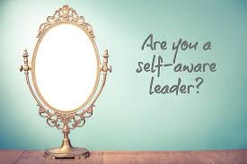
LEAD Myself – Developing Self Awareness
"It is wisdom to know others; it is enlightenment to know one's self.”
– Lao-Tzu, Chinese philosopher
Notes:
Need to check review these.

Slide 4

LEAD Myself – Developing Self Awareness
Self-awareness is one of the most important qualities that you can have as a leader, and developing self-awareness is important in both your personal and professional life.
Researchers Shelley Duval and Robert Wicklund published the first major theory of self-awareness in the early 1970s. They said that self-awareness is the ability to look inward, think deeply about your behavior, and consider how it aligns with your moral standards and values.

Slide 5
LEAD Myself – Developing Self Awareness
Research shows a strong link between self-awareness and high-performance in managers.
If you're aware of your own strengths and weaknesses, you have the power to use your strengths intentionally, and to manage or eliminate your weaknesses.
Researchers found that leaders who were aware of their strengths were more self-confident, were more highly paid, and were happier at work.
Having self-awareness allows you to approach people and situations with confidence. In turn, this means that you gain control of your own life, direction, and experiences.
Why Self-Awareness Is Important

Slide 6
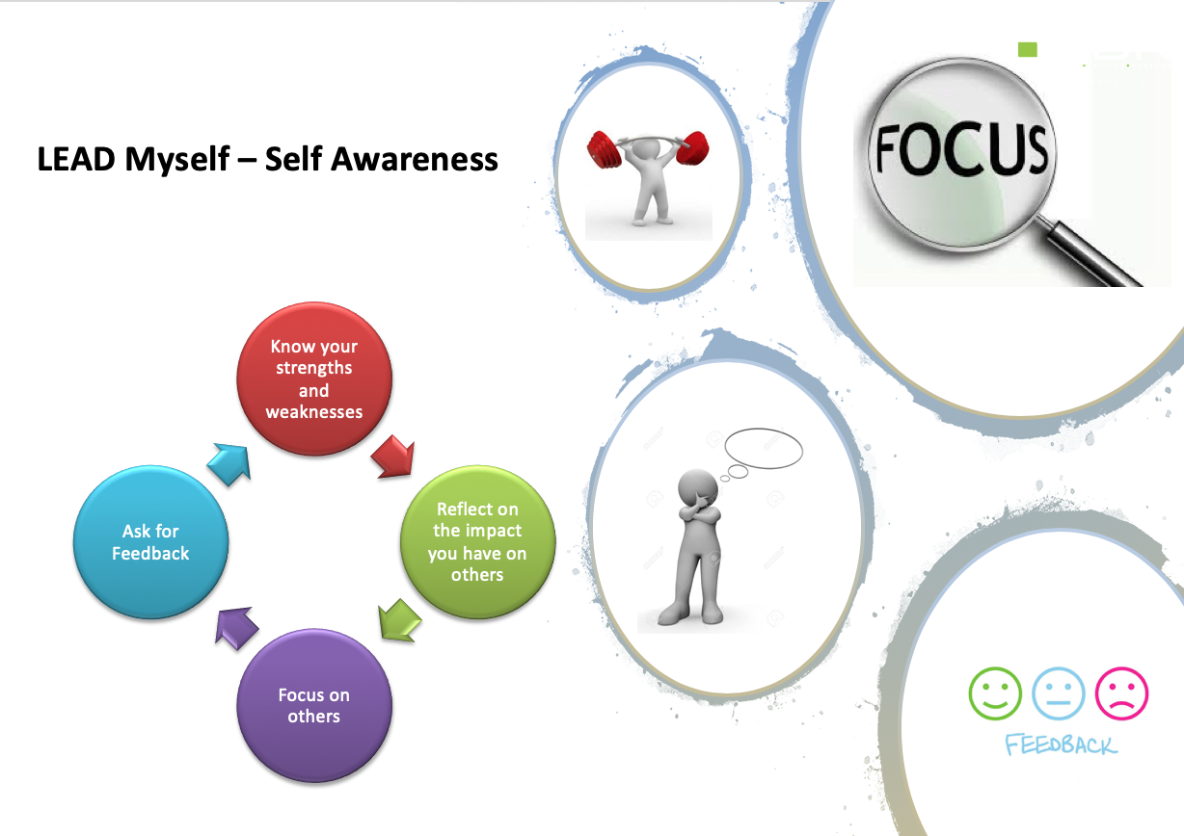

Slide 7
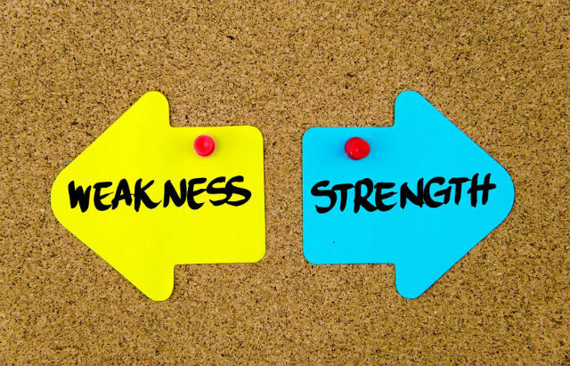
LEAD Myself – Developing Self Awareness
Know Your Strengths and Weaknesses
You can start building self-awareness by learning where you are strongest and weakest. Conduct a Personal SWOT Analysis to get a better understanding of this. You might also want to take the StrengthsFinder self-test, which helps you identify your five greatest strengths.
When you understand how your personality compares with the personalities of other people, you can discover what motivates you, and how you relate to the world. Both of these are important aspects of self-awareness.
This is where personality tests such as the Big Five Personality Model
and Myers-Briggs® can be valuable tools for self-discovery.

Slide 8

LEAD Myself – Developing Self Awareness
2. Reflect on the Impact You Have
When you are self-aware, you understand how you instinctively think, connect with other people, communicate, and make decisions.
A great way to understand these things is to keep a journal, where you write about your day, the things that you did, the emotions you experienced and expressed, and the consequences of these. This helps you think about what does and doesn't work for you, and helps you be more aware of your impact on other people.
Alternatively, take a break for five or 10 minutes a day and meditate.
Meditation helps broaden and strengthen your self-awareness, and it can also lower stress.
Or take time in the evening to reflect quietly about your day, and think about how effectively you worked with people. What did you do really well? And what could you have done better?

Slide 9

LEAD Myself – Developing Self Awareness
3. Focus on Others
People who are self-aware are conscious of how their words and actions influence others.
To become more aware of how you affect others, learn how to manage your emotions
. Take time to weigh what you say carefully, and think about how it will affect the person that you're speaking to.
If you find yourself taking your stress, anger, or frustrations out on others, stop immediately. Instead, see if you can find something positive about the situation. Take a few deep breaths, or even walk away if you find that you can't control your emotions.
When you manage your own words or actions, it doesn't mean that you're being false. Rather, it shows that you care about other people enough not to say or do something that might affect them in a negative way.
Showing humility is an important part of this. When you're humble, you focus your attention and energy on others and not on yourself.

Slide 10

LEAD Myself – Developing Self Awareness
4. Ask for Feedback
Getting feedback is important for developing self-awareness – after all, this is often the only way that you can find out about issues that you may not be able to face directly. (See our article on the Johari Window for more on this.)
You can get feedback from your colleagues and team members, either with direct questions or with 360° Feedback
. When you ask for feedback from the people around you, this gives you a chance to see your behavior from their point of view. What's more, it can help you identify weaknesses that you can't see, or that you'd prefer to ignore.

Slide 11

LEAD Myself – Self Awareness
Video Series (20 minutes)
Self Awareness, Authenticity and Leadership ( Video by Bill George)
Notes:
Need to check review these.

Slide 12
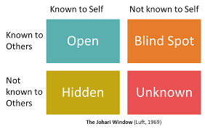
LEAD Myself – Self Awareness
The Johari Window - Building Self-Awareness and Trust
Key Points
Joseph Luft and Harry Ingham developed the Johari Window in 1955. It's a simple but powerful visual tool for developing self-awareness, and for building trust and better workplace relationships.
It is divided into four quadrants: Open Area, Blind Area, Hidden Area, and Unknown Area. These represent what a person knows about herself, and what others know about her.
The Johari Window shows how self-disclosure and feedback can help you to grow, both personally and professionally. It demonstrates the importance of open communication and its effect on group trust.
Your Open Area expands vertically with self-disclosure, and horizontally with feedback from other people. By encouraging healthy self-disclosure and sensitive feedback, you can build a stronger and more effective team.
Refer to article on Johari Window
Johari Exercise
Notes:
Need to check review these.

